Slide 1

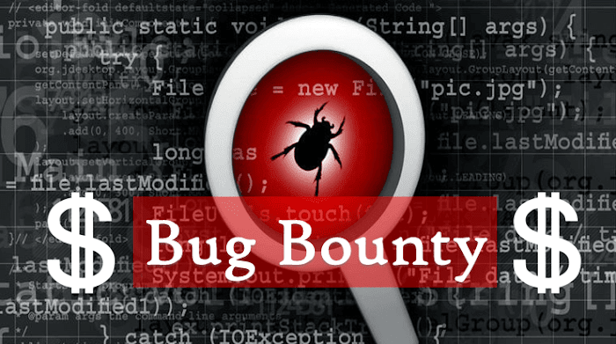
What Is
Notes:
Today I’m going to cover a few foundational areas regarding cybersecurity.
We’ll discuss the “why’s” of cybersecurity and its importance.
We’ll then talk about the sectors that are challenged by today’s cybersecurity issues.
Finally, we’ll take a look at a few of the organizations and documents that help support organizational activities when
confronted with cybersecurity challenges.
So, let’s begin!

Slide 2
What is a “Bug”?
A bug is an error, flaw, or issue that causes it
to produce an unexpected result.
Most bugs arise from errors in program design or source code
A famous story is that Operators traced an error in the Mark II – a computer in 1947 – to a moth trapped in a component, coining the term “bug”.
Notes:
First, technology is always evolving
Practically every day there’s a new technology created or new app, or new website becoming available attempting to make things faster, cheaper, and more simple.
Example: banking apps are now coming out with free checking and not from the typical banks like Chase or Bank of America. Coinbase now offers direct deposit of funds to your coinbase account converted to cryptocurrency fee free.
Another challenge is that we have no idea when a technology coming or when it’s happening or if it’s over
Again, we’re in the midst of a def or decentralized financei revolution with Blockchain technology that offers bitcoin, ethereum, and the other cryptocurrencies
Never 100% secure
Because a technology is created by a human, nothing is 100% safe. Humans are viewed as the weakest link in the technology chain.
Another challenge is that not enough people to fill jobs (estimated 3.5 million jobs)
(Show tab) Using Cyberseek.org, you can view the number job openings at the national and state levels.
And lastly, cybersecurity can be very expensive
Recruiting, hiring, training, hardware, software, legal fees, all of these things add up to be major expenses for organizations today!

Slide 3

Famous bugs in history
In 1996, the Ariane 5 rocket launched by the ESA exploded just forty seconds after its launch. The reason behind its failure was an integer overflow.
In 1999, the Mars Climate Orbiter crashed while entering the
planet’s orbit. The issue was that one team used the metric
system, while another group used the Imperial system.
In 2014, the music video ‘Gangnam Style’ broke Youtube
because it hit the maximum of a 32-bit integer (aka more than 2,147,483,647 views)
Notes:
First, technology is always evolving
Practically every day there’s a new technology created or new app, or new website becoming available attempting to make things faster, cheaper, and more simple.
Example: banking apps are now coming out with free checking and not from the typical banks like Chase or Bank of America. Coinbase now offers direct deposit of funds to your coinbase account converted to cryptocurrency fee free.
Another challenge is that we have no idea when a technology coming or when it’s happening or if it’s over
Again, we’re in the midst of a def or decentralized financei revolution with Blockchain technology that offers bitcoin, ethereum, and the other cryptocurrencies
Never 100% secure
Because a technology is created by a human, nothing is 100% safe. Humans are viewed as the weakest link in the technology chain.
Another challenge is that not enough people to fill jobs (estimated 3.5 million jobs)
(Show tab) Using Cyberseek.org, you can view the number job openings at the national and state levels.
And lastly, cybersecurity can be very expensive
Recruiting, hiring, training, hardware, software, legal fees, all of these things add up to be major expenses for organizations today!

Slide 4
WHY Bug Bounty?
Bug Bounty: Enhancing Cybersecurity through Ethical Hacking.
Ethical hacking has emerged as a robust shield safeguarding the digital realm
Bug bounty programs are a collaborative initiative
Several Platforms Available
Different Types of Bounties
Notes:
Therefore, the all important question is for everyone is, “What is cybersecurity?”.
A working definition of cybersecurity is, “the practice of protecting computers and their networks against unwanted access and the loss of data or theft.
Four main points that are relevant to this definition of cybersecurity are:
The prevention of unwanted access to your information either personal use or business use or potentially both.
By thinking in a “cybersecurity” mentality mode, users should keep their files and data secure and private when online
For those interested in the cybersecurity sector, hopefully all of you, major job growth is projected over the next several years which should be very enticing for starting a cybersecurity career!
Cybersecurity is continually evolving as an industry so tomorrow may look different from today due to new threats, viruses, attacks, digital forensics tools, etc.

Slide 5

WHO ARE THE BUG HUNTERS?
All over the world
All levels of experience
Passionate about security
All ages
Like a challenge
Want to make the Internet more secure!
Notes:
First, technology is always evolving
Practically every day there’s a new technology created or new app, or new website becoming available attempting to make things faster, cheaper, and more simple.
Example: banking apps are now coming out with free checking and not from the typical banks like Chase or Bank of America. Coinbase now offers direct deposit of funds to your coinbase account converted to cryptocurrency fee free.
Another challenge is that we have no idea when a technology coming or when it’s happening or if it’s over
Again, we’re in the midst of a def or decentralized financei revolution with Blockchain technology that offers bitcoin, ethereum, and the other cryptocurrencies
Never 100% secure
Because a technology is created by a human, nothing is 100% safe. Humans are viewed as the weakest link in the technology chain.
Another challenge is that not enough people to fill jobs (estimated 3.5 million jobs)
(Show tab) Using Cyberseek.org, you can view the number job openings at the national and state levels.
And lastly, cybersecurity can be very expensive
Recruiting, hiring, training, hardware, software, legal fees, all of these things add up to be major expenses for organizations today!

Slide 6


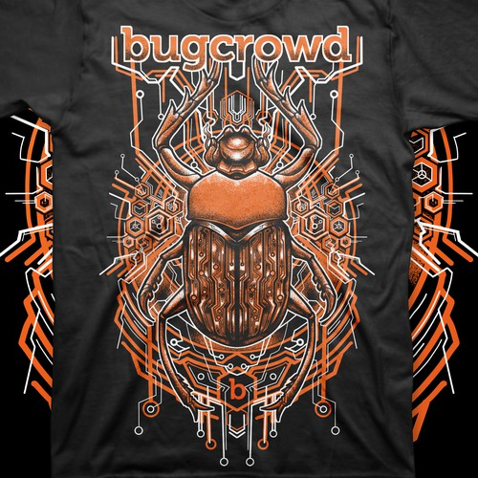
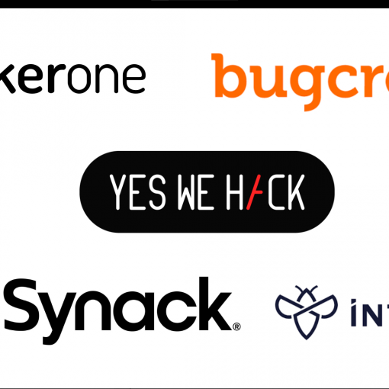
Platforms
Bugcrowd - known for its more experienced and professional researcher community, often attracting seasoned individuals with extensive expertise in the field.
HackerOne - A leading bug bounty platform connecting businesses with ethical hackers.
‹#›
Notes:
Let’s now discuss the CyberSecurity CIA Triad.
When first hearing the acronym CIA, I’m sure some of you may have thought CIA stood for Central Intelligence Agency.
However, in this program and context CIA stands for Confidentiality, Integrity, and Availability.
A triad is a group of three connected things, hence the three points for the green pyramid that you see.
These three points on the triangle comprise the CIA’s security philosophy which are:
The top point is confidentiality which is the protection through defining and enforcing access levels of information
An example is the separation of sensitive information from necessary accessible information.
The second point is integrity which is designed to protect data from deletion or modification from anyone who is unauthorized to do so.
The second component of integrity is that if a change does occur that the change is reversible so that the integrity of the data is in intact.
An Example is a PDF is readable by all but only modifyable by the author of the document.
The third point is availability which refers to the availability of the data.
Essentially, this component requires authentication mechanisms, access channels and systems to work properly so that information is protected and ensured.
An example is the high availability in that, data is redundantly accessible if even a system crashes, hardware fails, or even if a power outage occurs.

Slide 7
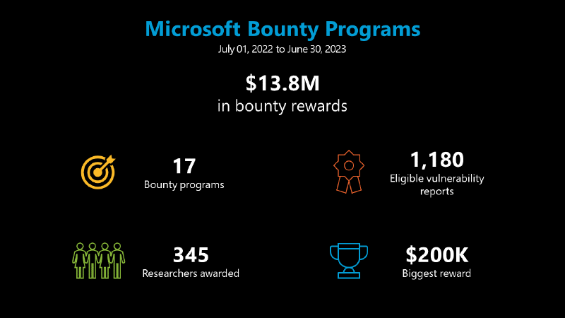
Notes:
First, technology is always evolving
Practically every day there’s a new technology created or new app, or new website becoming available attempting to make things faster, cheaper, and more simple.
Example: banking apps are now coming out with free checking and not from the typical banks like Chase or Bank of America. Coinbase now offers direct deposit of funds to your coinbase account converted to cryptocurrency fee free.
Another challenge is that we have no idea when a technology coming or when it’s happening or if it’s over
Again, we’re in the midst of a def or decentralized financei revolution with Blockchain technology that offers bitcoin, ethereum, and the other cryptocurrencies
Never 100% secure
Because a technology is created by a human, nothing is 100% safe. Humans are viewed as the weakest link in the technology chain.
Another challenge is that not enough people to fill jobs (estimated 3.5 million jobs)
(Show tab) Using Cyberseek.org, you can view the number job openings at the national and state levels.
And lastly, cybersecurity can be very expensive
Recruiting, hiring, training, hardware, software, legal fees, all of these things add up to be major expenses for organizations today!

Slide 8
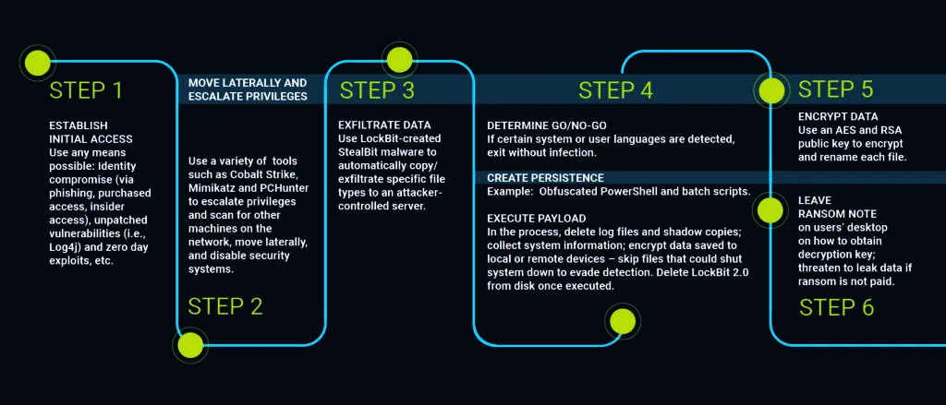
Rules of Engagement
Discovery: Finding vulnerabilities using various tools and techniques.
Reporting: Documenting the vulnerability, including how it can be replicated and the potential impact.
Resolution: Collaborating with the company to resolve the issue.
Reward: Receiving recognition or compensation for the effort.
Notes:
First, IOT or the internet of things is the connection of a device to the Internet.
Examples: Kitchen appliances like a Toaster, smart watches, Ev cars, etc.all are examples of IOT
Artificial Intelligence or AI which is where machines are programmed with special programming code to “think” and perform tasks typically performed by humans.
Example: Chatbots, all types of robots, and again self driving vehicles
Cloud computing is the replacement of physical hardware with software and virtualization warehoused in data centers throughout the world.
Example: Oracle Cloud Infrastructure, Amazon Web Services, Google Cloud Platform, and Microsoft Azure

Slide 9


THE COST OF NOT DOING CYBERSECURITY
$500m
$1t
2022- 1 bank spent over
$500 million to fight cyber crime
(FORTUNE)
2017-2023 - An estimated $1 trillion was spent on cybersecurity (CYBERSECURITY VENTURES)
$22b
$217
2024 - Government will spend a projected $22 billion on cybersecurity
(WHITE HOUSE)
estimated cost per record per data breach in the US
(FORBES)
‹#›
Notes:
Dissimilar to other organizational operations such as marketing and sales, cybersecurity can be a very expensive endeavor.
For example, an undisclosed bank spent more than $500 million dollars in 2015 to fight its ongoing cyber crime.
Another example was the US government which spent in 2017 an amount of $19 billion on their activities to defend against cybersecurity attacks.
From the past four years, an estimated one trillion dollars was spent on cybersecurity according to cybersecurity ventures.
And lastly, an estimated $217 dollars was the estimated cost per record per data breach in the US, according to Forbes magazine.
Even these are just estimates, the cost to defend and protect against cybersecurity is continuing to grow along with the need to employ more cybersecurity workers which means the continuation of job growth in this job sector.

Slide 10
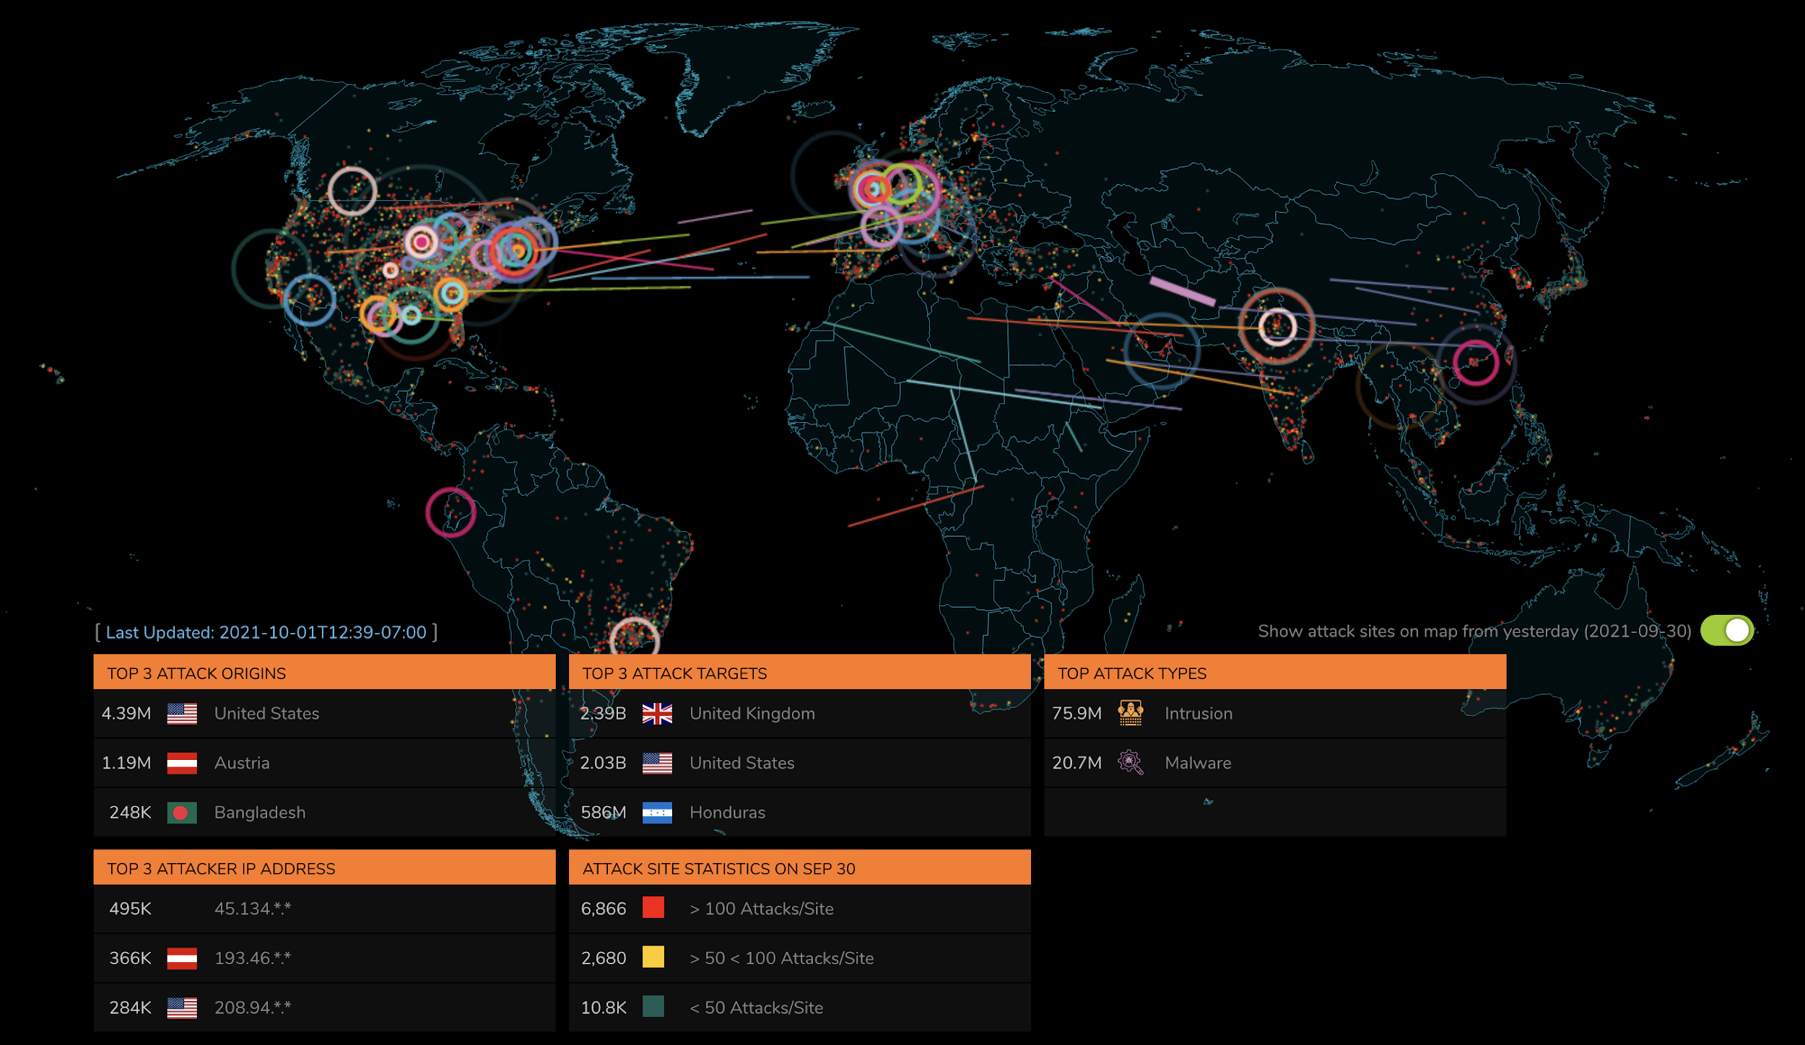
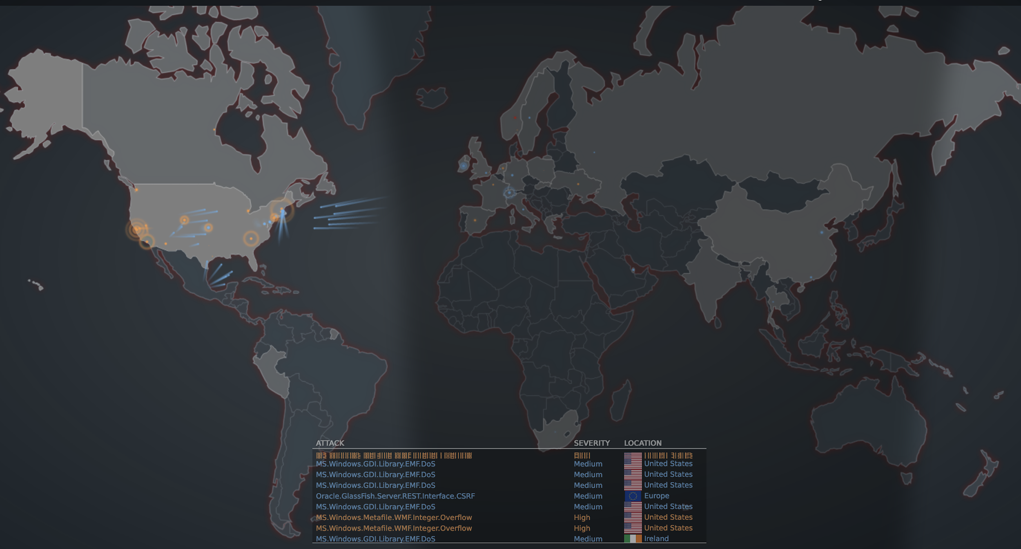
The Threat Lanscape
https://attackmap.sonicwall.com/live-attack-map/
https://threatmap.fortiguard.com/
Notes:
These two images that you see are screenshots of cyber attacks taken from the Sonicwall and Fortinet websites.
These two sites provide real-time attacks globally in a visual and graphical perspectives.
Let’s take a look at each attack map now by clicking on the images...

Slide 11

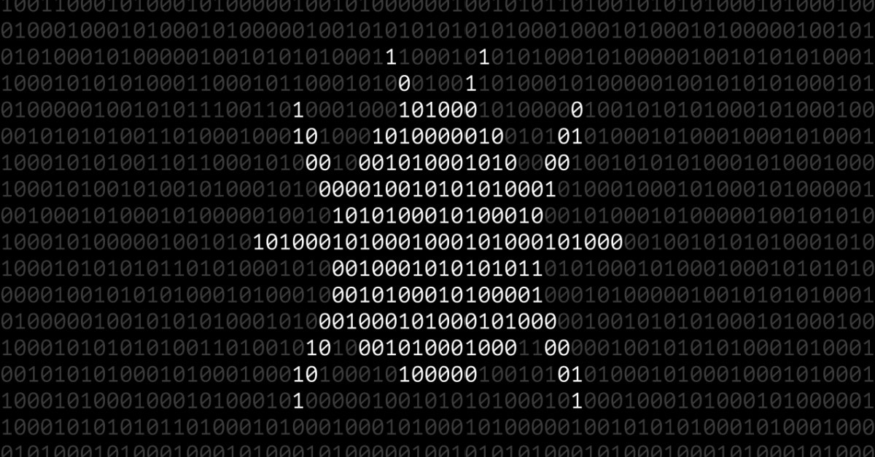

Notes:
Thank you for listening and being attentive so I’ll now turn this back over to Matt and Will for continuing onward, thank you!

